Slide 2

Recommendation system progress report

Slide 3
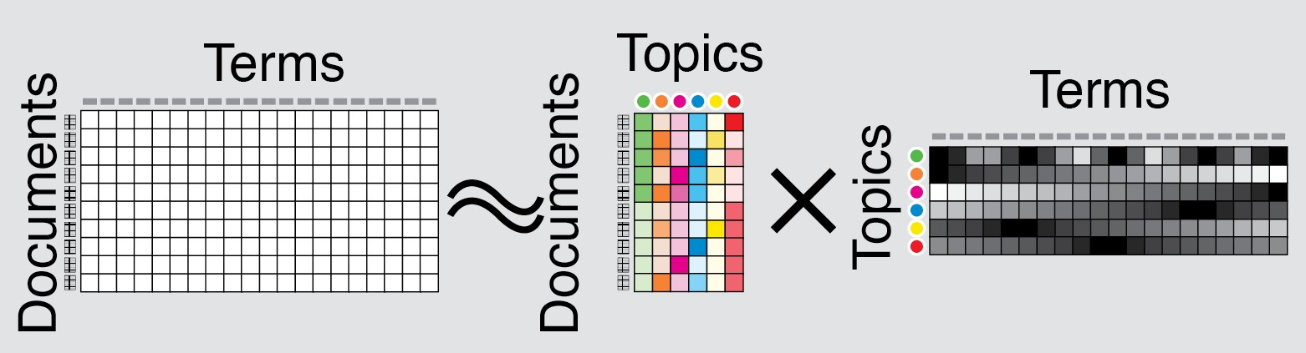
1. Latent factor model
The idea is to find the underlying data pattern in the user-rating matrix by compressing it
“If meaningful generalities can help you represent your data with fewer numbers, finding a way to represent your data in fewer numbers can often help you find meaningful generalities.”
-Simon Funk-

Slide 4
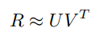
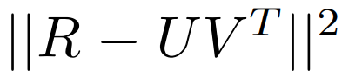
1. Latent factor model
Matrix Factorization: the m x n ratings R with rank y matrix is approximately factorized into an m x k matrix U and an n x k matrix V, where k < y:
The error of this approximation is equal to:
Many matrix factorization methods exist, the key differences is
the constraints imposed on U and V (e.g., orthogonality or non-negativity)
The nature of the objective function (e.g., minimizing the Frobenius norm or maximizing the likelihood estimation).

Slide 5
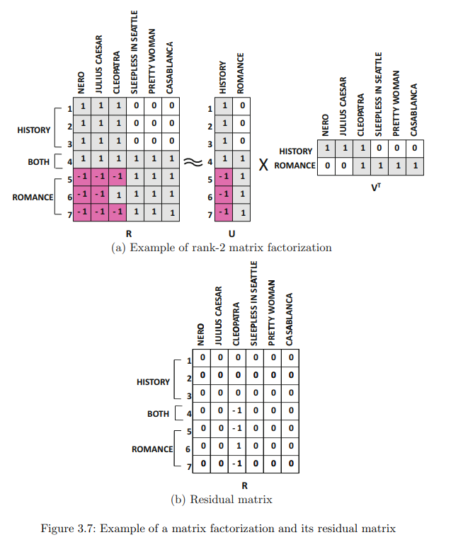
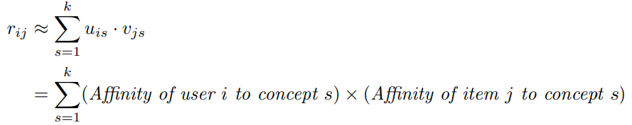
1. Latent factor model
The i-th row u_{i} of U: user factor, contains k entries corresponding to the affinity of user i towards the k concepts in the ratings matrix.
The i-th row v_{i} of V: item factor, represents the affinity of the i-th item towards these k concepts.

Slide 6
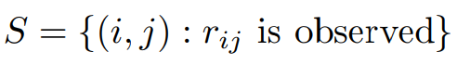
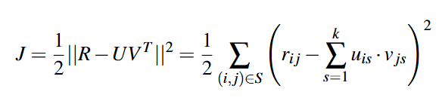
1.1 Unconstrained Matrix Factorization
Denote the set of all observed user-item pairs as:
Factorize the incomplete matrix R as the approximate product of fully specified matrices UV^{T} then all the entries in R can be predicted.
Minimize the Frobenius norm:
Subject to: No constraints on U and V

Slide 7
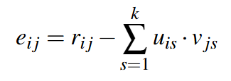
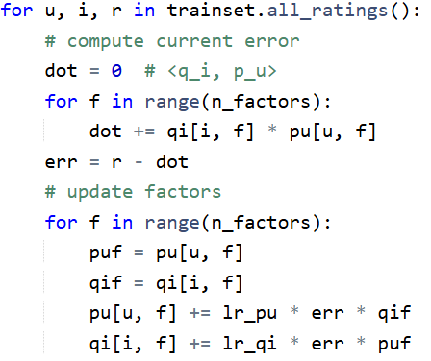
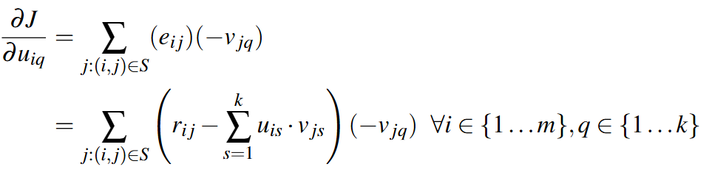
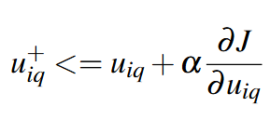
1.1 Unconstrained Matrix Factorization
Gradient descent:
Radom initialize U and V, usually small values
Compute the error:
Calculate the partial derivatives with respect to each entries of U and V:
Update the value:

Slide 8
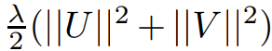
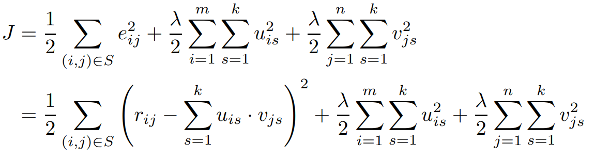
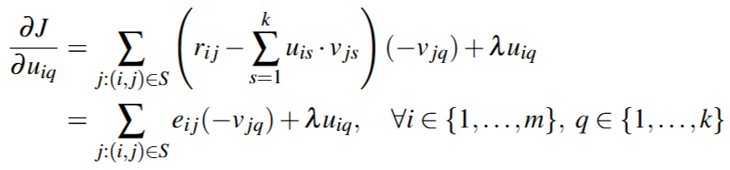
1.2 Matrix Factorization with Regularization
R high sparsity usually leads to overfitting -> Regularization
Discourage very large values of the coefficients in U and V in order to encourage stability
Add a regularization term to the objective function:
Minimization process is performed similar to unconstrained case, with added regularization term to the derivatives:

Slide 9
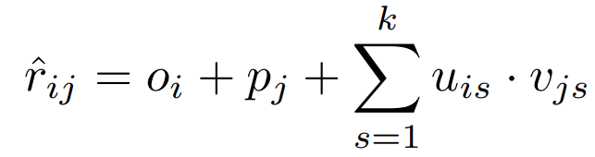
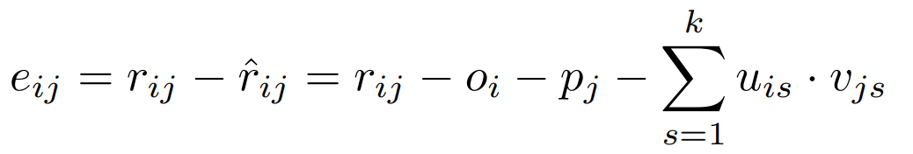
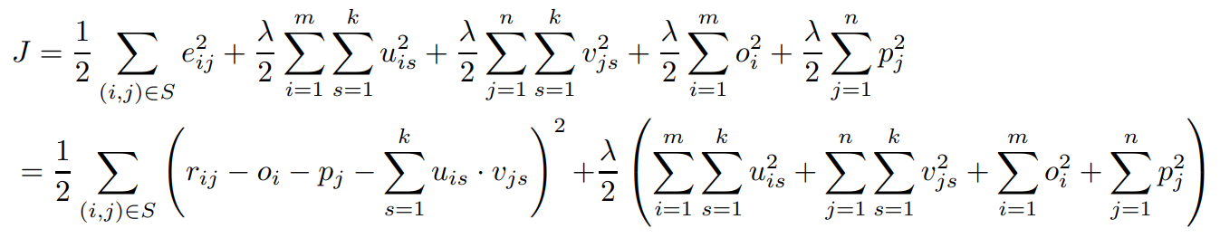
1.3 Incorporating User and Item Biases
Denote the user bias as o_{i} and item bias as p_{j}
Learn the bias in a data driven way:
New objective function:

Slide 10
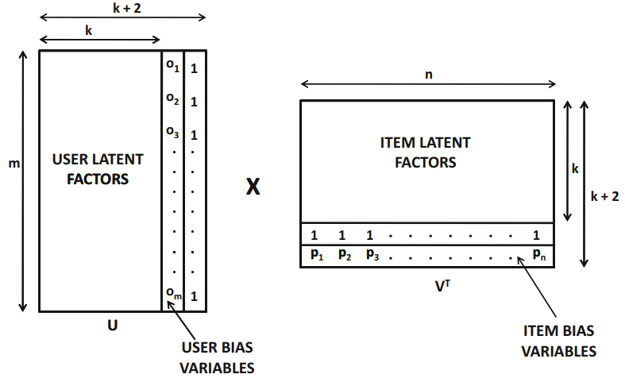
1.3 Incorporating User and Item Biases
The new learning process can be modeled as a Matrix Factorization model with addition bias columns and rows in U and V

Slide 11
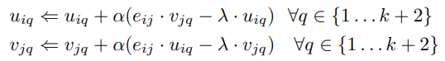
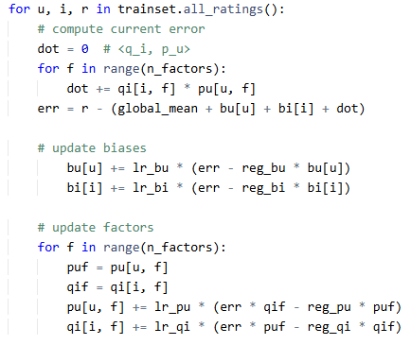
1.3 Incorporating User and Item Biases
Variables update:
Additional bias and regularization terms

Slide 12
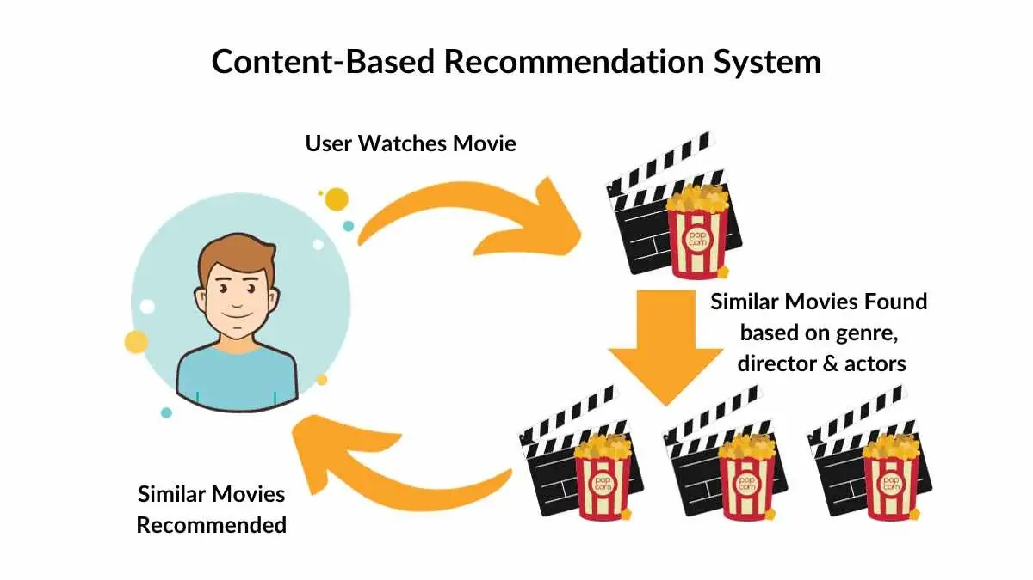
2. Content based recommender
Utilize items description, metadata to generate recommendation
Basic component of Content-Based Systems:
Preprocessing and feature extraction
Content-based learning of user profiles
Filtering and recommendation

Slide 13
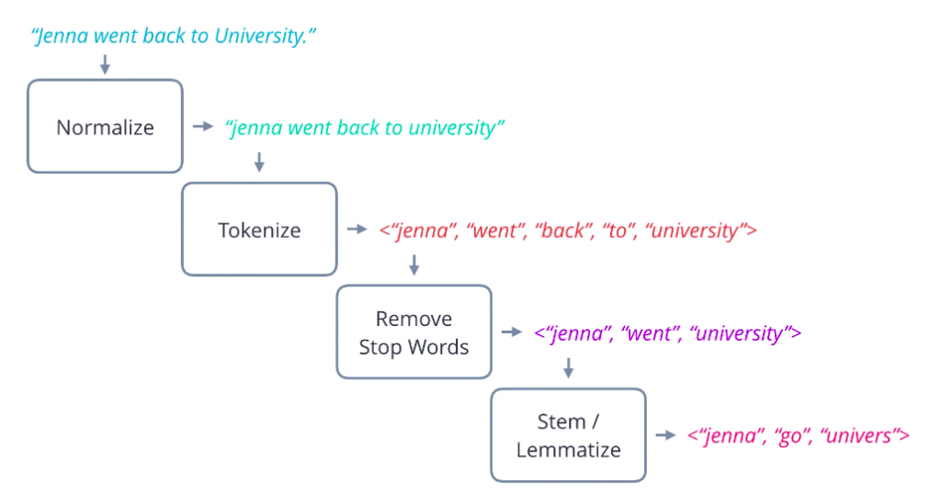
2.1 Preprocessing and feature extraction
Features are extracted from various sources (description, tags, ...) and converted to a keyword-based vector-space representation
Cleaning methods:
Stop-word removal: remove general high-frequency words
Stemming: consolidate variations of word
Phrase extraction: Detect words that occur together

Slide 14
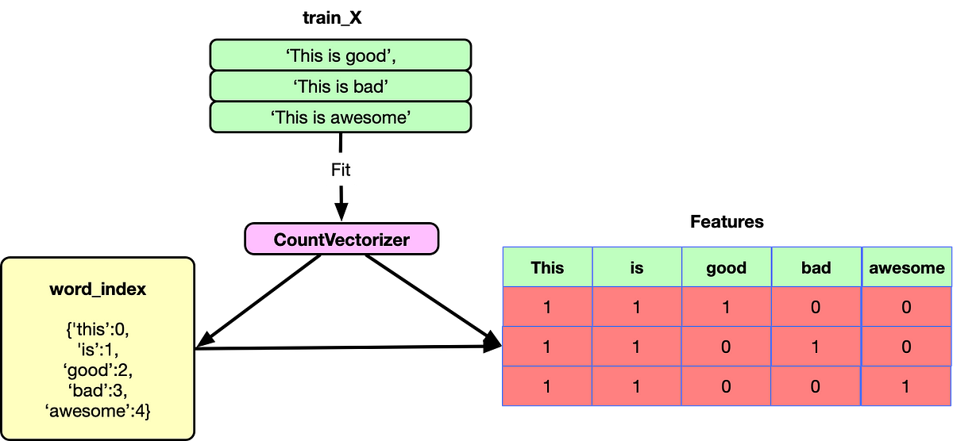
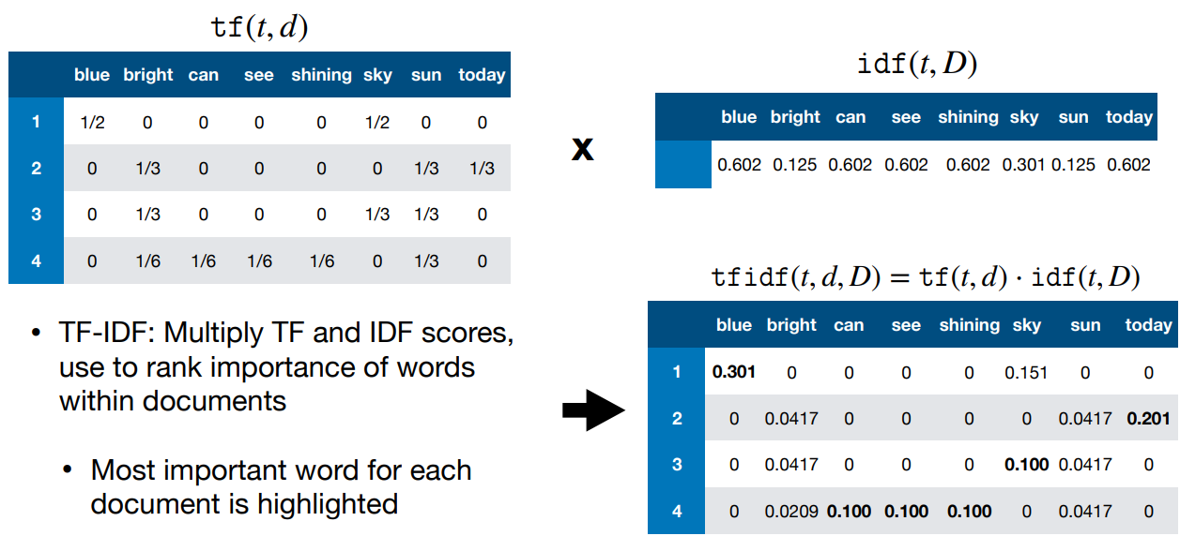
2.1 Preprocessing and feature extraction
Extracted features is converted to vector-space representation
Documents are represented as bags of words, together with their frequencies
CountVectorizer: transform the corpus to a matrix of token counts
TfidfTransformer: transform the matrix of token counts to a tf-idf matrix

Slide 15
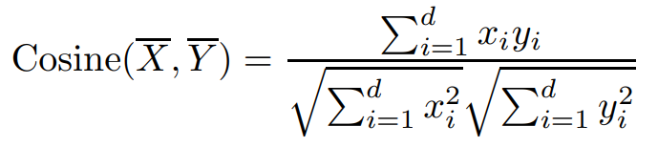
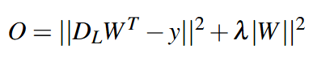
2.2 Content-based learning of user profiles
Nearest Neighbor Classification: Define a similarity function: Cosine similarity
Regression-Based Models:
D_{L} be an n × d matrix representing the n documents in the labeled training set
y be an n-dimensional column vector containing the ratings of the active user for the n documents in the training set
Find the matrix W that minimize the objective function:

Slide 16
THANK YOU !

